Slide 1
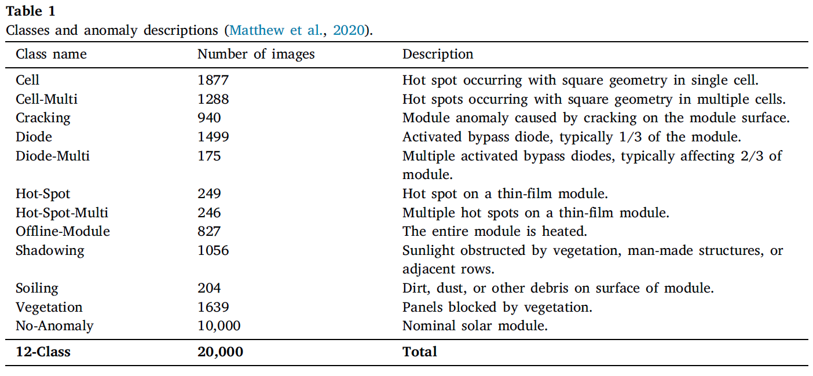

Slide 2
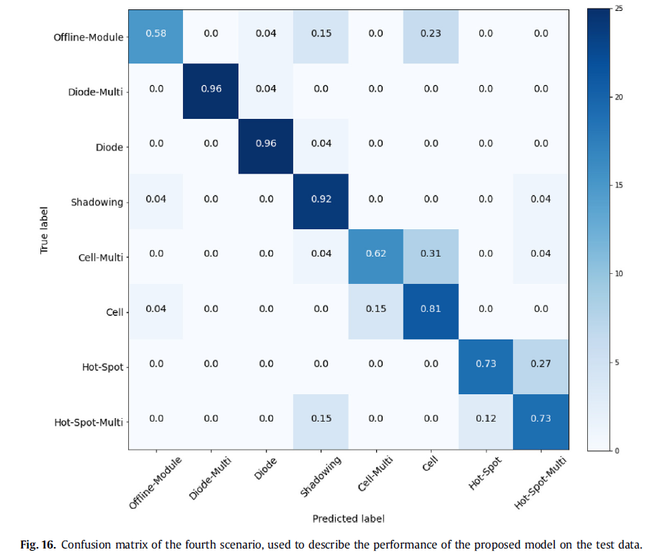
1. Automatic fault classification in photovoltaic modules using Convolutional Neural Networks
CNN's testing accuracy was estimated as 92.5% for the detection of anomalies in PV modules and 78.85% to classify defects for 8 selected classes
AFC

Slide 3
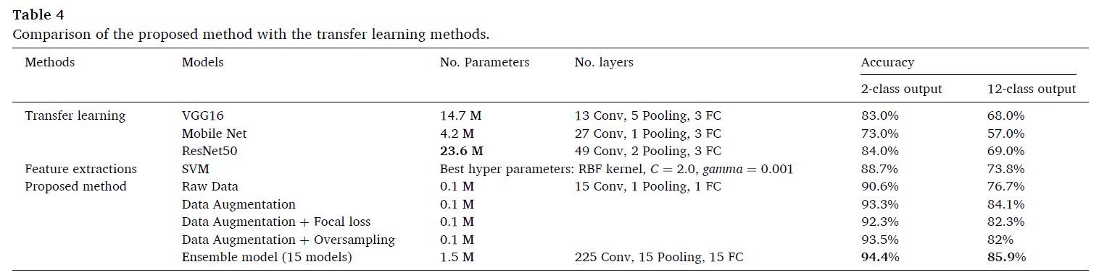
2. Remote anomaly detection and classification of solar photovoltaic modules based on deep neural network
The proposed model could predict an anomaly module on an average of 94%
and correctly classify 12 anomaly types on an average of 86%

Slide 4
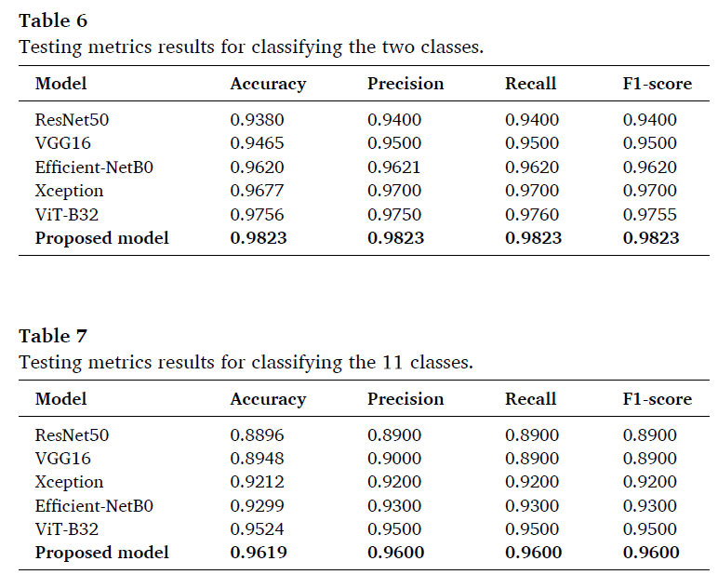
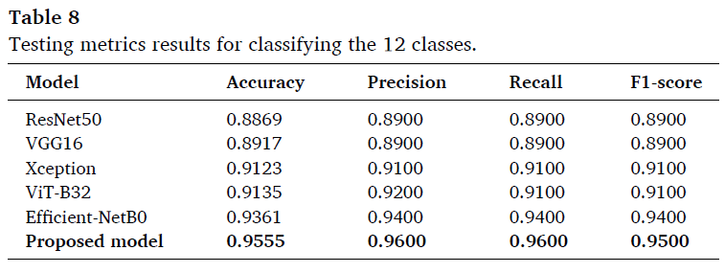
4. An innovative transformer neural network for fault detection and classification for photovoltaic modules
The results show that our proposed approach has 98.23% accuracy for classifying the dataset into two classes, one for the PV anomaly and the other for the no-anomaly. It also has 96.19% accuracy for classifying eleven PV failures and 95.55% for twelve classes, including the no-anomaly class with the eleven types of anomalies.

Slide 5
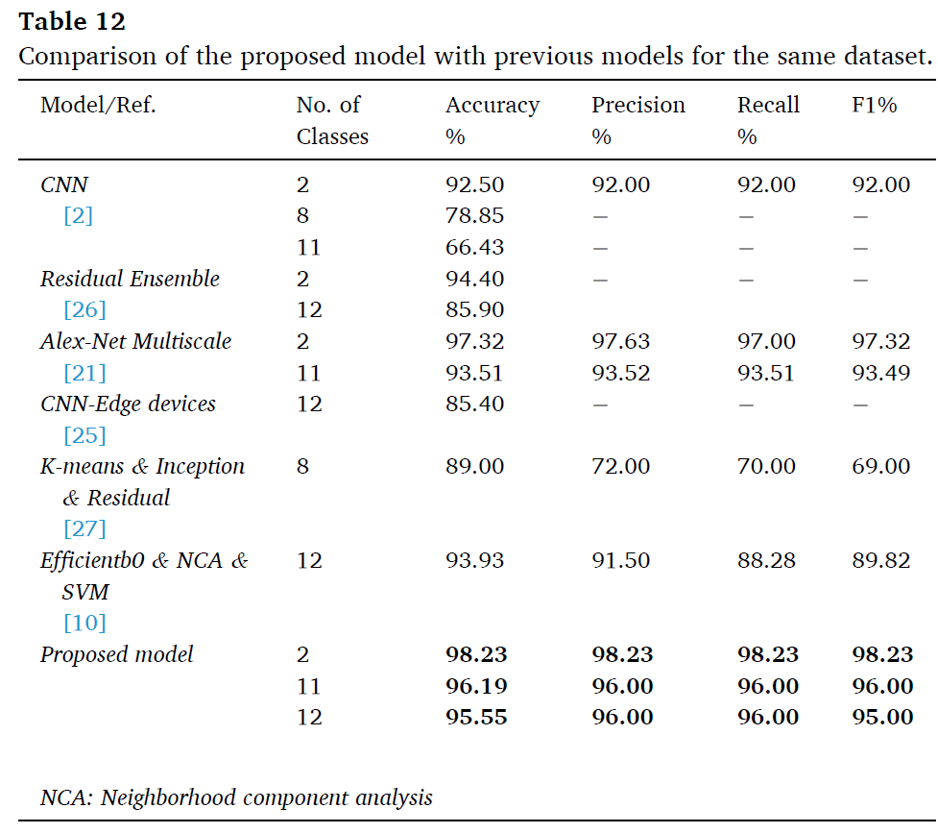
Continued…

Slide 6
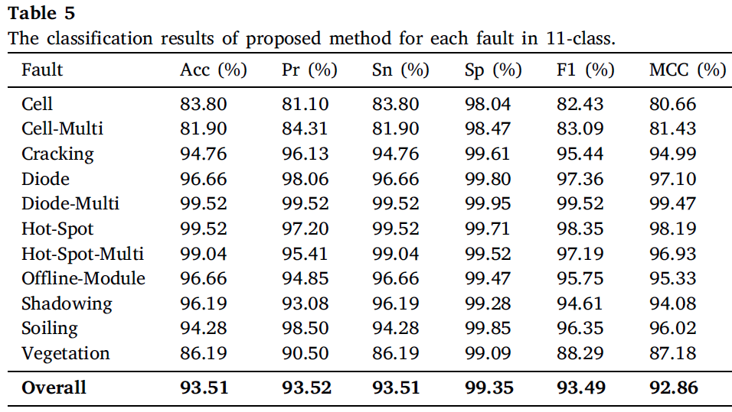
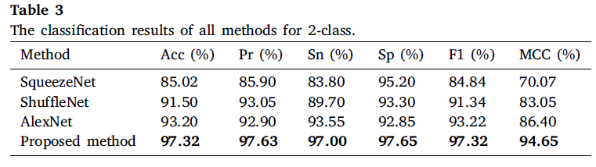
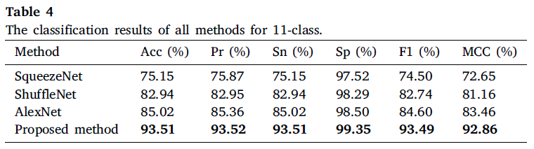
5. An efficient fault classification method in solar photovoltaic modules using transfer learning and multi-scale convolutional neural network
The average accuracy is obtained as 97.32% for fault detection and 93.51% for 11 anomaly types

Slide 7
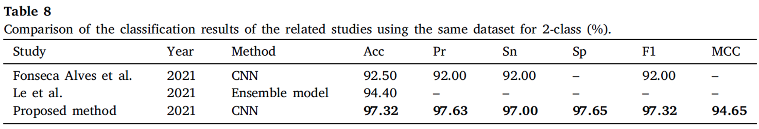
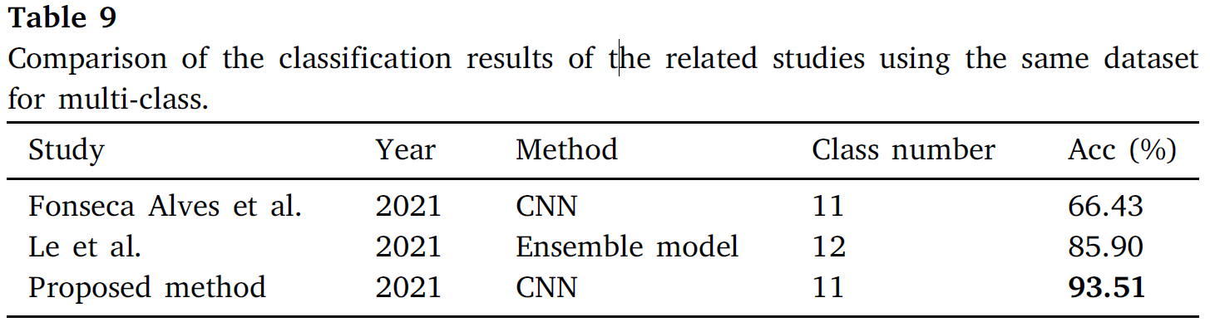
Continued…

Slide 8
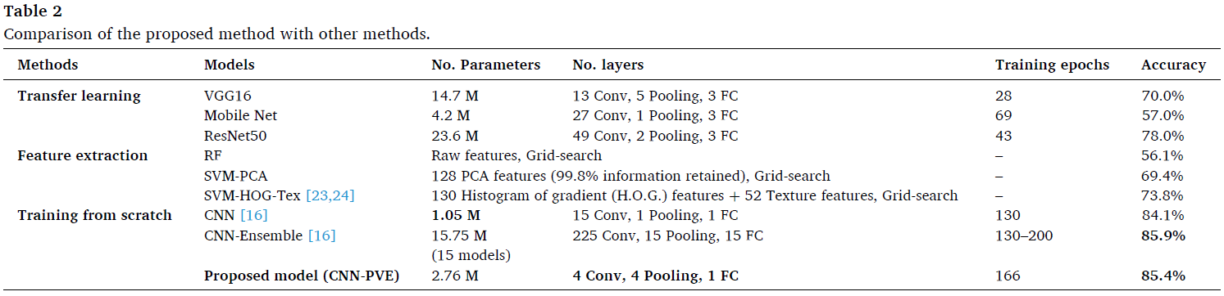
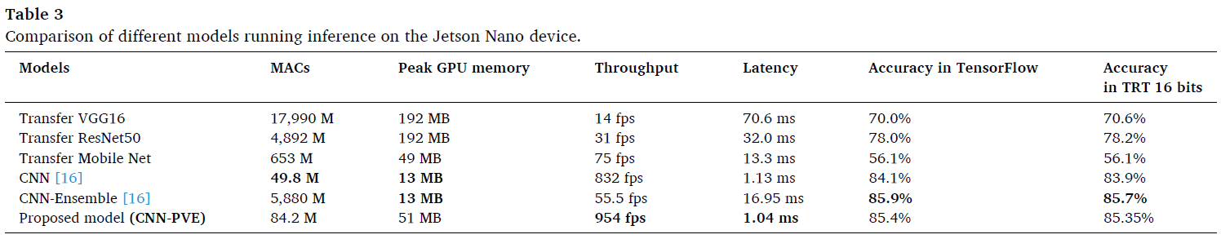
6. Thermal inspection of photovoltaic modules with deep convolutional neural networks on edge devices in AUV
The proposed CNN-PVE model provides a classification accuracy of 85.4% for 12 types of anomaly PV modules, which is better than other methods such as the Transfer Learning model, Random Forest, SVM, and previous CNN model [16]

Slide 9
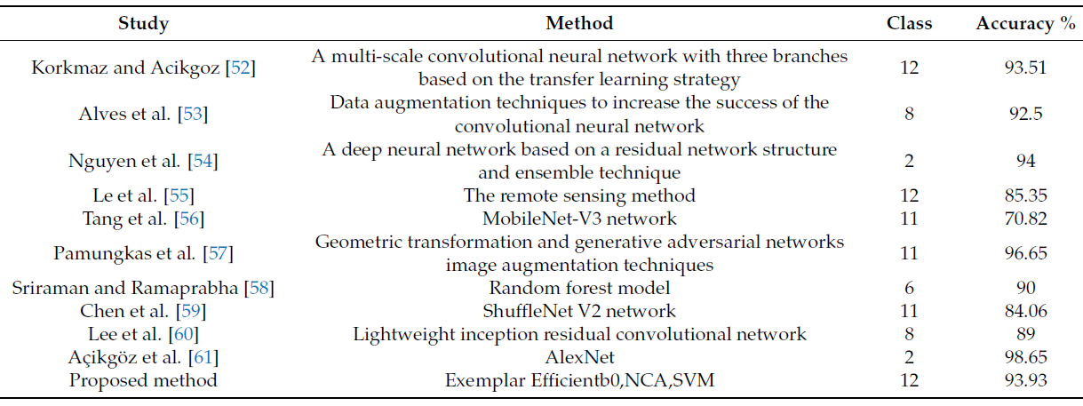
7. Fault Detection in Solar Energy Systems: A deep Learning Approach
These results indicate average values of 93.93% accuracy, 89.82% F1-score, 91.50% precision, and 88.28% sensitivity, respectively

Slide 10
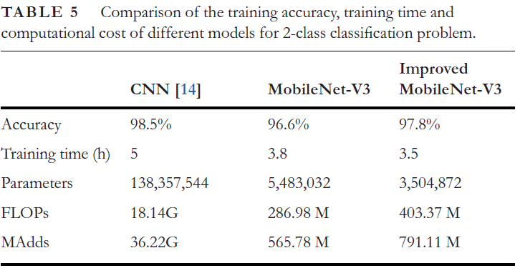
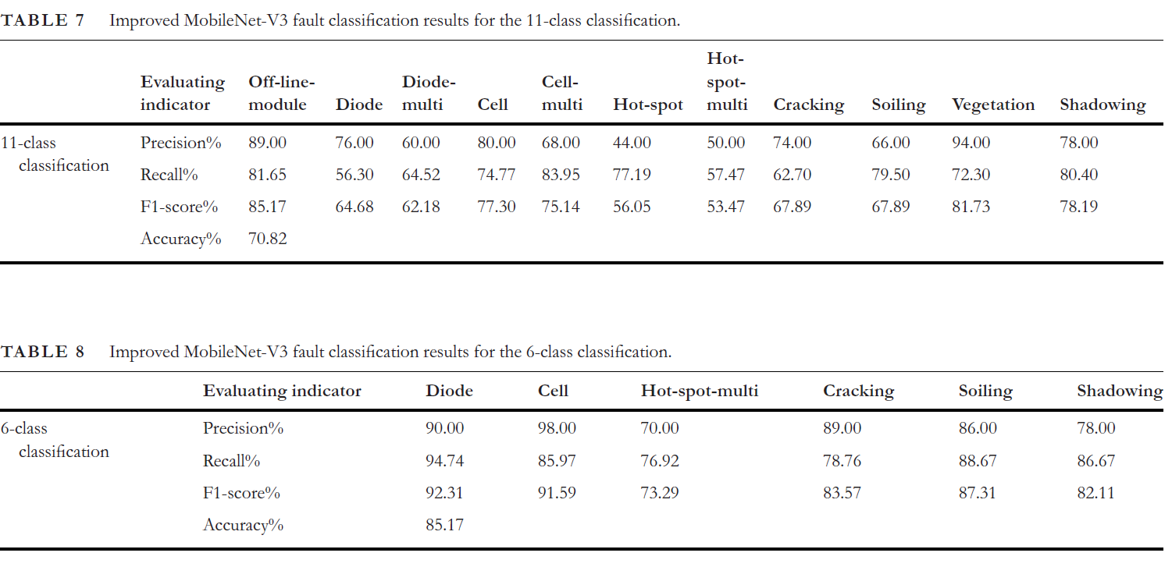
8. Automatic defect identification of PV panels with IR images through unmanned aircraft
In the diagnosis of 11 categories of anomalies, the accuracy reached 70.82%, which is 13.7% higher than the diagnostic accuracy of the CNN-based model. In the diagnosis of 6 categories of common abnormal components, the accuracy was 85.17%

Slide 11
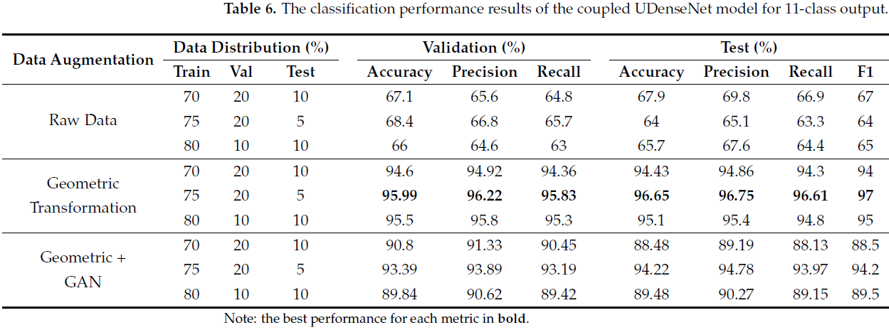
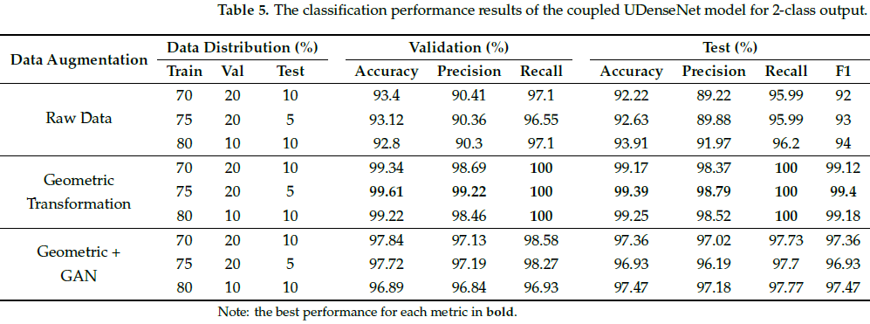
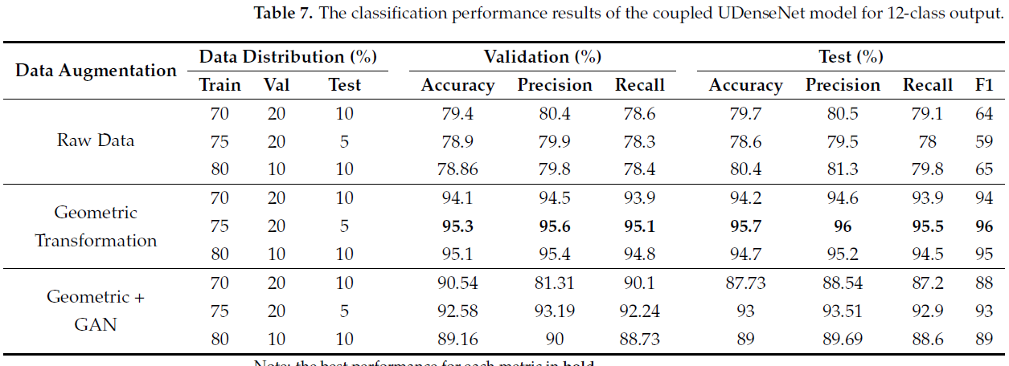
9. A Novel Approach for Efficient Solar Panel Fault Classification Using Coupled UDenseNet
The proposed lightweight coupled UdenseNet model shows significant improvements for PV fault classification compared to previous studies, achieving an accuracy of 99.39%, 96.65%, and 95.72% for 2-class, 11-class, and 12-class output, respectively

Slide 12
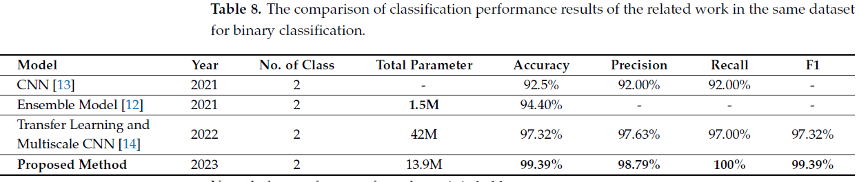
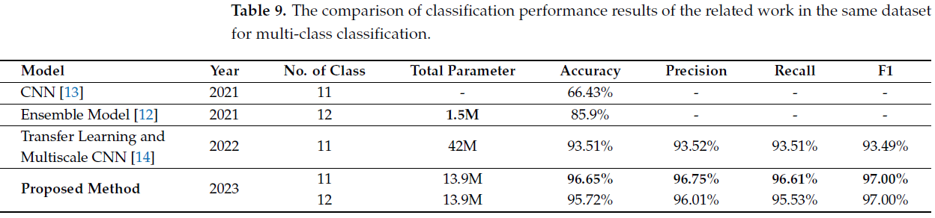

Slide 13
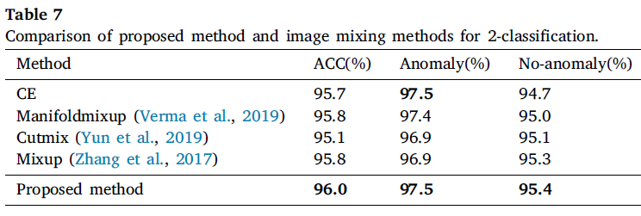
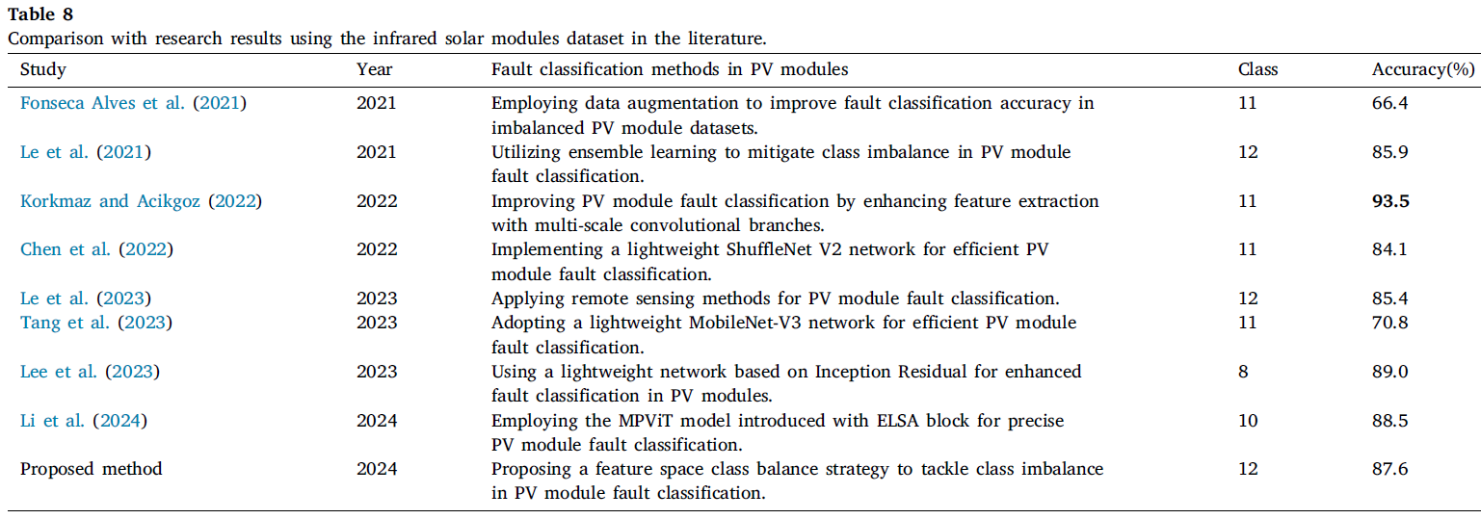
10. A feature space class balancing strategy-based fault classification method in solar photovoltaic modules
It achieved an average accuracy of 96.0% for 2- class classification and 87.6% for 12-class classification on the Infrared Solar Modules dataset

Slide 14
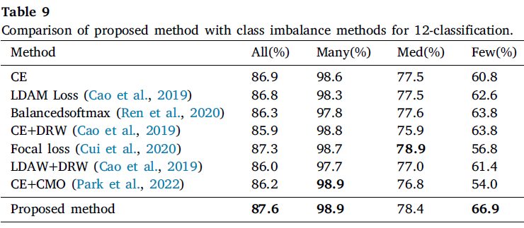
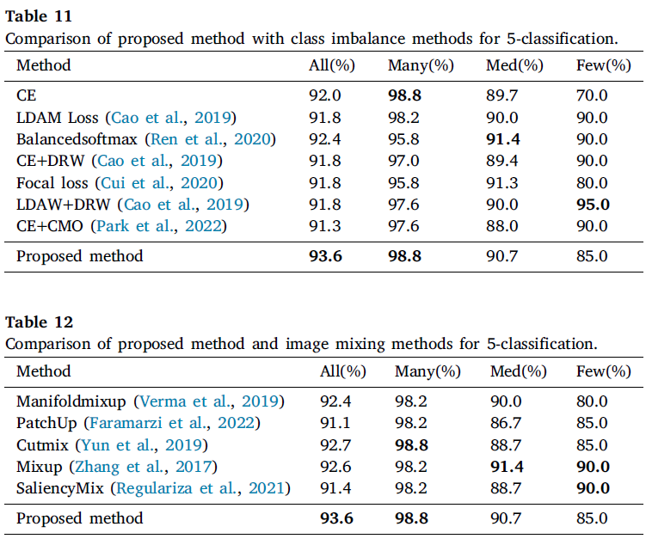
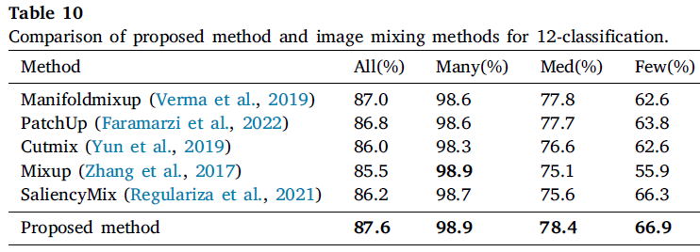

Slide 15
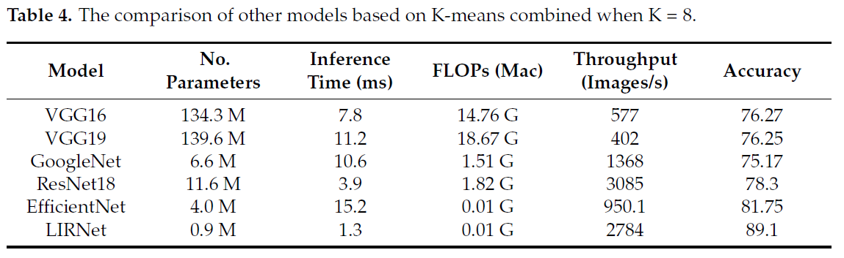
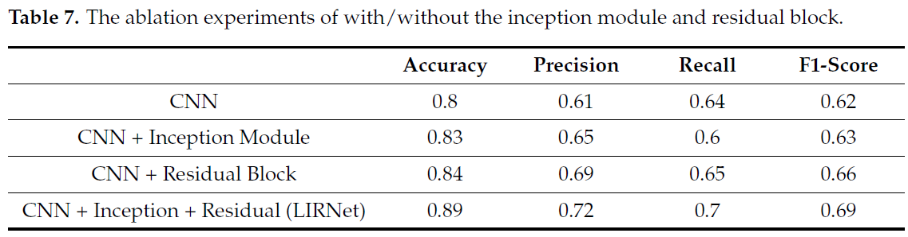
11. LIRNet: A Lightweight Inception Residual Convolutional Network for Solar Panel Defect Classification

